Slide 1



Introducere în analiza datelor de mari dimensiuni
Titlul proiectului: Educație și dezvoltare în era digitală
Cod proiect: POCU/860/3/12/143072
Model Building and Tuning with the tidymodels ecosystem
By Marin Fotache

Slide 2
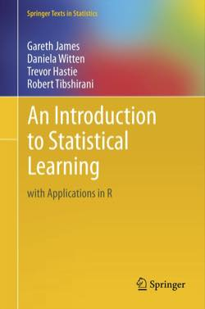
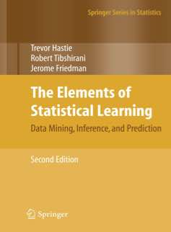
Main References (Free Books)
Gareth James, Daniela Witten, Trevor Hastie and Robert Tibshirani - An Introduction to Statistical Learning with Applications in R, Springer, 2013-2017, freely available at:
http://www-bcf.usc.edu/~gareth/ISL/index.html or http://web.stanford.edu/~hastie/pub.htm
Fundamentals of Data Science
Theoretical but with R examples
Excellent for beginers who seek to understand Data Science ingredients
Not easy
Trevor Hastie, Robert Tibshirani and Jerome Friedman - The Elements of Statistical Learning. Data Mining, Inference, and Prediction, Springer, 2009-2017, freely available at:
http://web.stanford.edu/~hastie/pub.htm
Even deeper fundamentals of Data Science
Theoretical but with R examples
Mathematical
Quite difficult for non-statisticians

Slide 3
Agenda
What are model hyper-parameters
Main hyper-parameters for tree-based ensemble models:
Bagging
Random Forest
Boosting
Grid search and other types of hyper-paramenter combinations of candidate values
Choosing the best model
Model tuning and cross-validation
Model tuning in tidymodels:
Package tune
Package dial

Slide 4
Web Resources on Model Tuning with `tidymodels`
Max Kuhn | Total Tidy Tuning Techniques | RStudio (2020)
https://www.youtube.com/watch?v=amg8bByYwSY&t=1102s
TidyX Tidymodels (https://www.youtube.com/playlist?list=PLdb0LTjA9iQyCgTd8MmRS38vYrRIzdx2j)
TidyX Episode 80 | Tidymodels - Decision Tree Tuning (2021)
https://www.youtube.com/watch?v=7cKKFKHw-L8&list=PLdb0LTjA9iQyCgTd8MmRS38vYrRIzdx2j&index=4
TidyX Episode 82 | Tidymodels - Tuning a Random Forest (2021)
https://www.youtube.com/watch?v=L32snM7KsQw&list=PLdb0LTjA9iQyCgTd8MmRS38vYrRIzdx2j&index=6
TidyX Episode 83 | Tidymodels - Naive Bayes of Penguins (2021)
https://www.youtube.com/watch?v=JhePa_FMHlQ&list=PLdb0LTjA9iQyCgTd8MmRS38vYrRIzdx2j&index=7
TidyX Episode 84 | Tidymodels - Workflow Sets and model selection (2021)
https://www.youtube.com/watch?v=YZqbOATpjM4&list=PLdb0LTjA9iQyCgTd8MmRS38vYrRIzdx2j&index=8
TidyX Episode 85 | Tidymodels - Tuning Workflow Sets (2021)
https://www.youtube.com/watch?v=69RfA9hZANg&list=PLdb0LTjA9iQyCgTd8MmRS38vYrRIzdx2j&index=9
TidyX Episode 86 | Tidymodels - Julia Silge and Tune Racing (2021)
https://www.youtube.com/watch?v=yCAZwD3r8bw&list=PLdb0LTjA9iQyCgTd8MmRS38vYrRIzdx2j&index=10

Slide 5
Web Resources on Model Tuning with `tidymodels` (cont.)
TidyModels by Max Kuhn (2/24/2021)
https://www.youtube.com/watch?v=kAZe9UpMx_s
Machine learning with {tidymodels} Tutorial (UseR! Conference 2022) 9:45:26!!!!
https://www.youtube.com/watch?v=QiIwhDri1jM
Tidymodels Tutorial – Classification (BURAK DILBER, 2022)
https://www.kaggle.com/code/burakdilber/tidymodels-tutorial-classification
Tidymodels Tutorial - Regression (BURAK DILBER, 2022)
https://www.kaggle.com/code/burakdilber/tidymodels-tutorial-regression
How to make many models with TidyModels: Classification (part 1 of Oregon Spotted a Frog series) (2022)
https://www.youtube.com/watch?v=RbVbFXDkV68
NHS-R Conference Workshop: Building a TidyModels model from scratch – 01/11/22
https://www.youtube.com/watch?v=CEh-jeQdOqA

